Slide 1
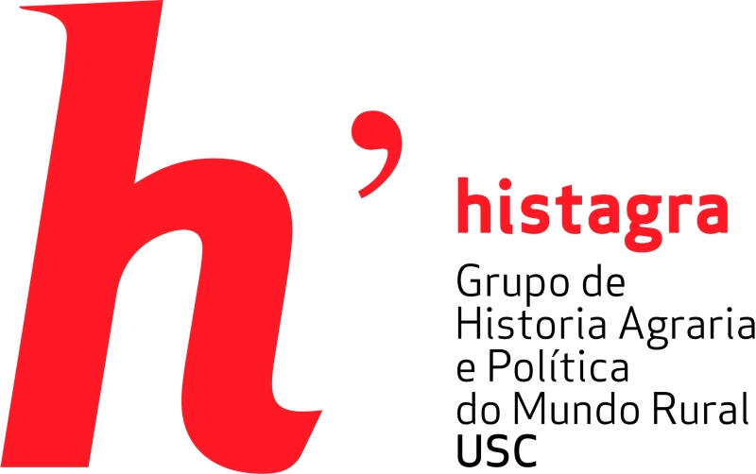
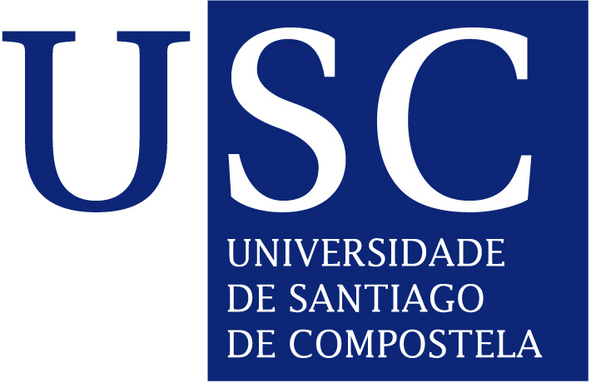
Old and New Plants from the Americas to Europe: Potatoes, Corn and the Genetics of Double Hybrid Corn (1800-1940)
31/03/2016 European Social Science History Conference – Valencia (Spain)
Bruno Esperante, Beatriz Corbacho, Miguel Cabo and Lourenzo Fernández. Histagra – University of Santiago de Compostela

Slide 2
Galicia is in the north-west of Spain
It is a historical region
Different weather, more colder and raining than the rest of peninsula
Hegemonic social class are historically small holders
Maize is the most common corn instead wheat since late XVIIth century

Slide 3
Maize took only 30 years to become the most important corn in Galicia in the late seventeenth century.
Some structural effects was for example:
Increase in population that subsequently accentuated hereditary land division and exacerbated minifundismo: the micro-parcellation of lands that would later be so criticised.
The population also shifted from the interior toward the coast and has remained so to the present day, precisely in according to the better productivity of maize in coast.
The enormous production per hectare of this new crop with respect to other grains restructured the entire Galician agrosystem.

Slide 4
In early nineteenth century a complex rotation system of European and American grains, including fodder and meadow crops, began to change the landscape and a process of specialization of peasants economy in cattle farming.
So thus, maize played an important role as cattle feed in the development of the Galician agriculture and of course the economy of all peasants families.
However, the economy of small holders began to feel the effects of cheap agricultural imports of grains and frozen meat from the Americas.
The economy crisis in late nineteenth century did that European agriculture in general, including Galicia, was faced with the need to intensify, specialise or reorient production towards new markets.

Slide 5
Double hybrid maize, Cattle farming and new context with the application of science to agriculture 1888-1936.
Genetic improvements and agricultural intensification in the first third of the twentieth century.
Opening of the two main research institutions in Galicia:
1888, Farm School in A Coruña
1921, Galician Biological Mission in Santiago de Compostela
Cruz Gallástegui Unamuno, who worked as geneticist to improve the performance of corn through hybridization began in this institution. With the fin-de-siècle crisis, new global agricultural product markets needed competitive edges that could only be achieved by applying scientific innovation to agriculture.

Slide 6
Cruz Gallástegui de Unamuno 1891-1960. Director of Galician Biological Mission.
Gallástegui explained the need to increase corn production:
There are regions that overcome the backwardness of their agriculture with industrial advances, such as the Basque Country and Catalonia. Others overcome it by the vast extension of their land, as in the central plains and Andalusia. Galicia can do neither as it has no industry or equivalent surface, and with a growing population must intensify its agricultural and cattle crops to ensure that its economy keeps up with the times.

Slide 7
In the first stage of the Mission (1921-26)
46 varieties of Galician corn and 26 varieties of US corn were studied. Research efforts were also aimed at obtaining and maintaining pure strains for commencing hybridization, in order to achieve simple hybrids that would later allow the production of the double hybrid seed.
More specifically, seed improvement research in the 1920s and 1930s focused on selection:
“There is a great difference between one type of corn and another. Some varieties yield 1,800 kg/hectare while others planted and cultivated in the same way produce 5,000 kg/hectare. The reason for this difference is nothing more than the choice of one seed over another”.

Slide 8
Second stage of the Mission (1926-1936)
The Mission moved to the city of Pontevedra, where the Seed Producers Trade Union was created, an endeavour that benefitted from Gallástegui’s 1929 visit to the Svalof seed station in Sweden.
The Seed Producers Trade Union was responsible for distributing double hybrid corn seed to farmers willing to use it.
Corn innovation was not always well-received among relevant peers. Evidence points to a surprising lack of coordination among the various agricultural experimentation centres in Galicia at that time and to professional rivalry between Gallástegui and Ricardo de Escauriaza, Diretor of the A Coruña Farm School.

Slide 9
Ricardo de Escauriaza (1888-1952) Director of Farm School of Coruña.
About the Double hybrid maize:
“if the summer is cool and humid they do not mature well and if it is dry they require irrigation, which is not common here. Because of their height, they are easily blown down by the wind and their large cobs are mostly uncovered at the end, which leads to rapid growth of mould. Their long stalks bend so that the cobs touch the ground, where they get wet and stay wet, which also contributes to the growth of mould”

Slide 10
Epilogue Spanish Civil War 1936-1939
Cruz Gallástegui was targeted by the repressive mechanism of the regime but managed to disassociate his work from any political agenda or affinity with the Republic.
The Biological Mission was absorbed by the CSIC (Centro Superior de Investigaciones Científicas), and languished due to serious financial shortcomings throughout the 1940s.
The Seed Producers Trade Union was quickly destroyed by the new Falangist trade union organizations.
Agricultural objectives during the Franco era were different from those that enabled the main changes and innovations in American crops that we have examined here.

Slide 11
Thank you!

